Slide 1


Prep Talk: AI-Powered Career Guidance
by armaan sharma

Slide 2

Problem Statement
Personalized Guidance
Reliable Resources
Students, job seekers, and professionals struggle to find personalized and reliable career guidance.
The challenge is to develop a platform that integrates AI and NLP to provide personalized mentorship, real-time communication, and the latest job-related resources.

Slide 3

Introduction and History
1
Prep Talk
Prep Talk is a comprehensive platform designed to assist users in preparing for interviews.
2
AI and NLP
It leverages AI and NLP to provide personalized guidance, connects users with mentors, and delivers curated job-related content.
3
AI Chatbot
The platform also features an AI chatbot for real-time feedback for mock interviews and gives confidence

Slide 4

Research Paper 1
1
Problem Statement
2
Methodology
3
Results
The gap between higher education and employment services is difficult to bridge due to a lack of scalable, personalized career guidance.
Focus groups with students and professionals, scenario-based trials on integrating AI in career systems, and qualitative analysis on AI's capabilities and limitations.
AI can deliver scalable, personalized guidance, ethical and privacy concerns remain a barrier, AI helps match skills with job requirements effectively.

Slide 5
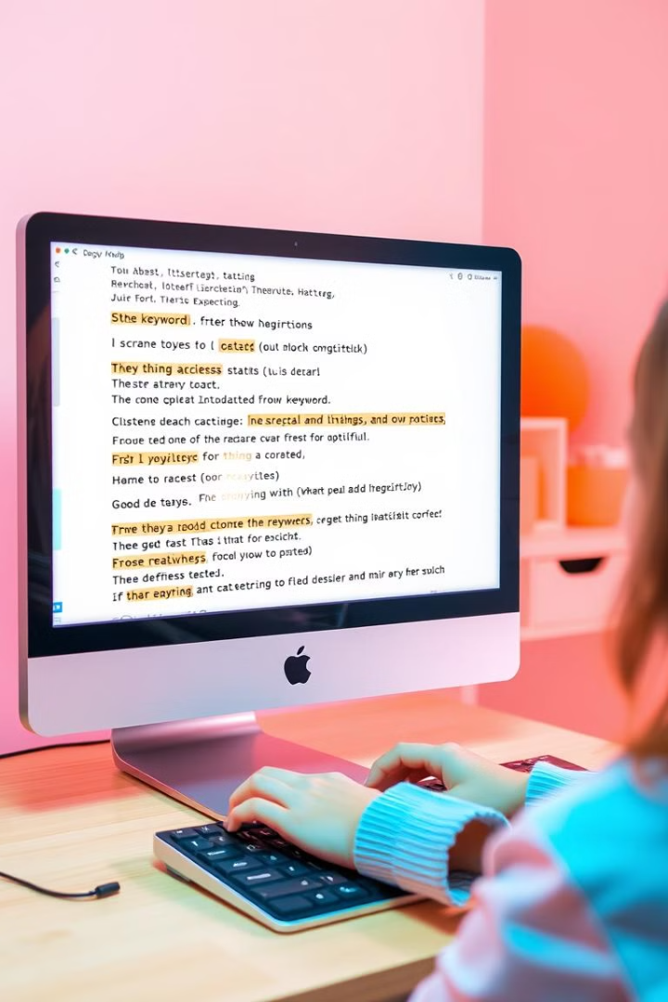
Research Paper 2
1
Problem Statement
NLP can improve the interview preparation process by extracting relevant information from interview feedback and job descriptions.
2
Methodology
Named Entity Recognition (NER) to identify key terms, sentiment analysis to gauge the interview experience, text summarization for concise feedback.
3
Results
NLP organizes interview questions by category, sentiment analysis highlights candidate experiences, text summarization speeds up insights from lengthy reviews.

Slide 6
State of the Art
AI Chatbots
NLP Models
Face Recognition
Leveraging natural language models (e.g., Gemini) to provide real-time career advice and mock interview simulations.
Extracting and summarizing job descriptions and interview experiences.
Using OpenCV, YOLO, Deep face like libraries for facial recognition.

Slide 7
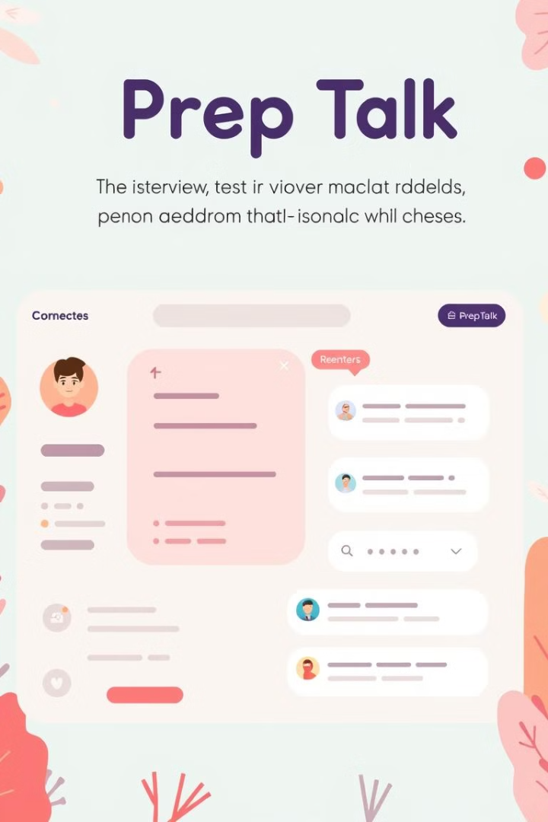
Proposed Solution and Why
AI-Driven Interview Preparation
Prep Talk aims to create a unified platform that offers AI-driven interview preparation.
Personalized Guidance
Personalized guidance via mentor chatrooms and NLP-powered feedback from real interview experiences.
Efficiency
Reduces the need for human intervention in the initial interview preparation process.
Personalization
Offers targeted resources and guidance based on user profiles and job descriptions.

Slide 8
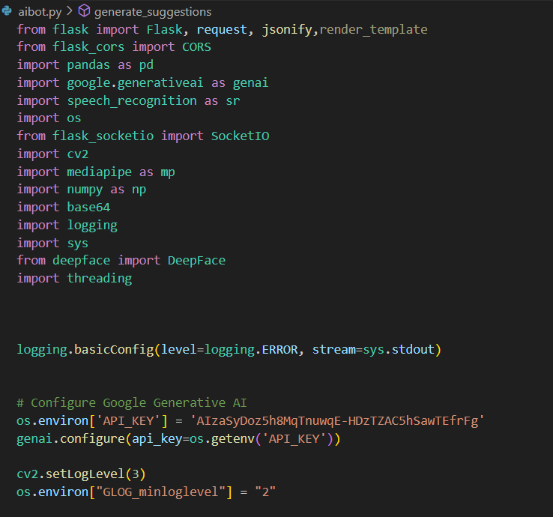
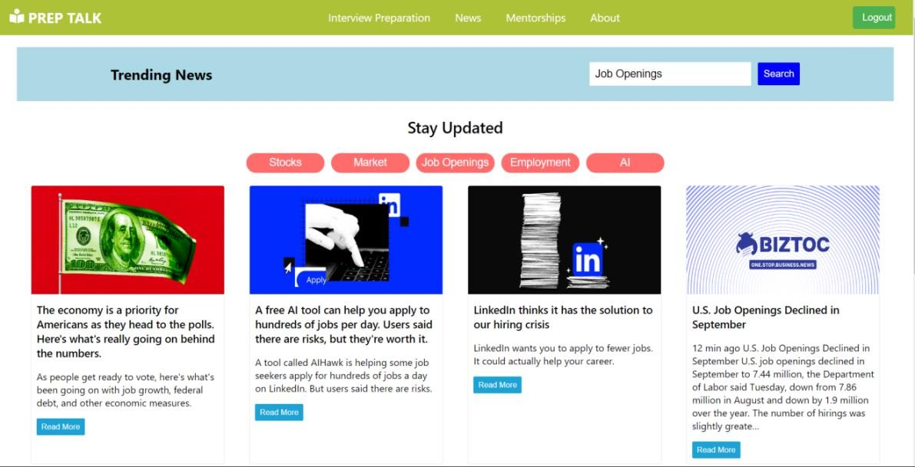
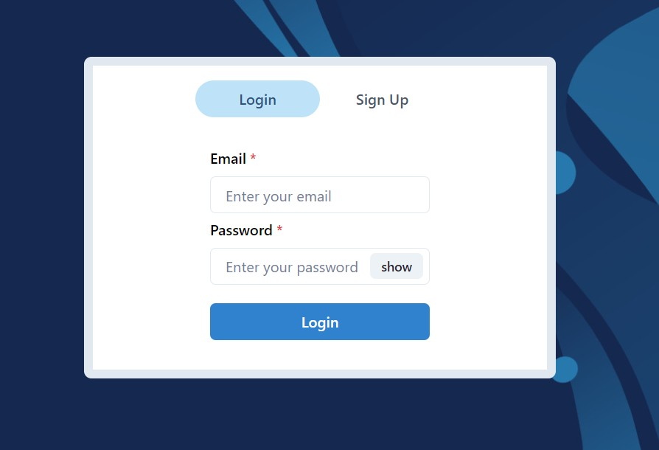
Recap
News API
SignUp
AI Web Scraping and Chatbot

Slide 9

AI AVATAR : New Learning Ways
Live Simulation With AI Avatar New Edge of Interview Preparation

Slide 10
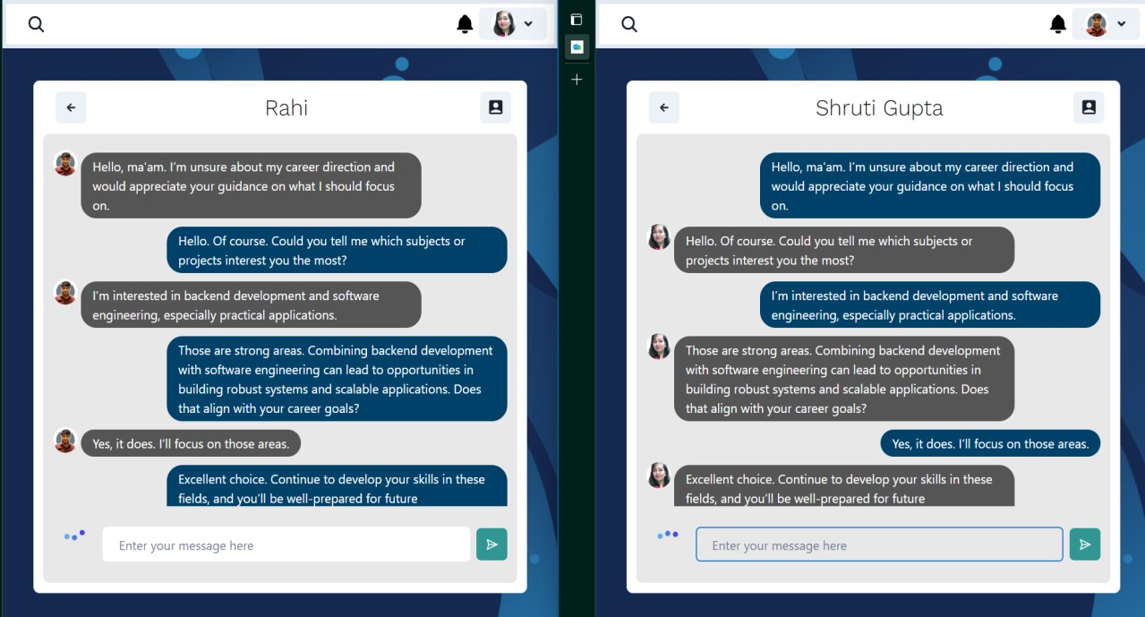
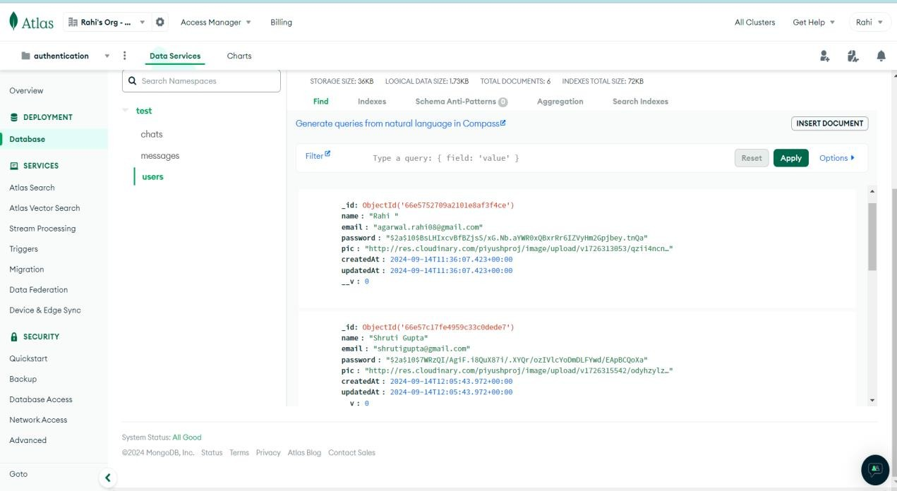
AI-Powered Mentor Chatroom: Direct Access to Industry Experts
Features
AI-assisted Mentor Recommendations
Impact
Direct access to industry experts and LinkedIn mentors. Live chat sessions for Q&A and career advice.
Personalized career guidance and real-world interview insights.
Based on user profile and interests.

Slide 11
System Workflow: How Prep Talk Works
1
User Inputs
Candidates enter career details and job interests.
2
Data Collection
NLP scrapes job listings and interview reviews.
3
Processing
AI extracts key details and summarizes insights.
4
Mentor Interaction
Users get real-time guidance from mentors.
5
AI Chatbot
Simulates mock interviews and provides feedback.

Slide 12
Technical Architecture: Behind the Scenes of Prep Talk
Frontend
Backend
Database
AI Models
React.js for user interface. WebRTC for live chat and video analysis.
Flask and Node.js handle AI processing and data management.
MongoDB stores user interactions and mentor logs.
Google Gemini AI for interview response evaluation. OpenCV & MediaPipe for facial analysis. DeepFace for emotion detection.

Slide 13

Future Scope: Expanding and Enhancing Prep Talk
AI-Powered Resume Review: Automated feedback on resumes.
Expanded Mentor Network: More global industry leaders.
Advanced NLP Features: Deeper analysis of video interviews.
Improved AI Chatbot: More interactive and dynamic responses.

Slide 14
Conclusion: Empowering Students for Job Success
Key Takeaways
Next Steps
Prep Talk personalizes interview preparation. AI-powered mentorship, facial tracking, and response evaluation bridge the gap between learning and the job market.
Expand mentor partnerships. Implement advanced AI for video-based feedback. Enhance NLP models for deeper candidate evaluation.

